Slide 1


Virtual Reality in Education
Team Members:
Zechen Song 001533496 Jiaqi Wang 001023711 Taizhou Qing 001560796

Slide 2
Agenda
Introduction
Development and Prospects
Why VR in education
Conclusion

Slide 3
Introduction
VR is used to build immersive, simulated 3D environments.
VR transports the person into a new environment.
Enables to interact with the virtual environment.

Slide 4
How Virtual Reality Works
Everything that we know about our reality comes by way of our senses
Virtual Reality is done with the use of special devices such as head-sets, gloves and more
Virtual reality is usually implemented using computer technology

Slide 5

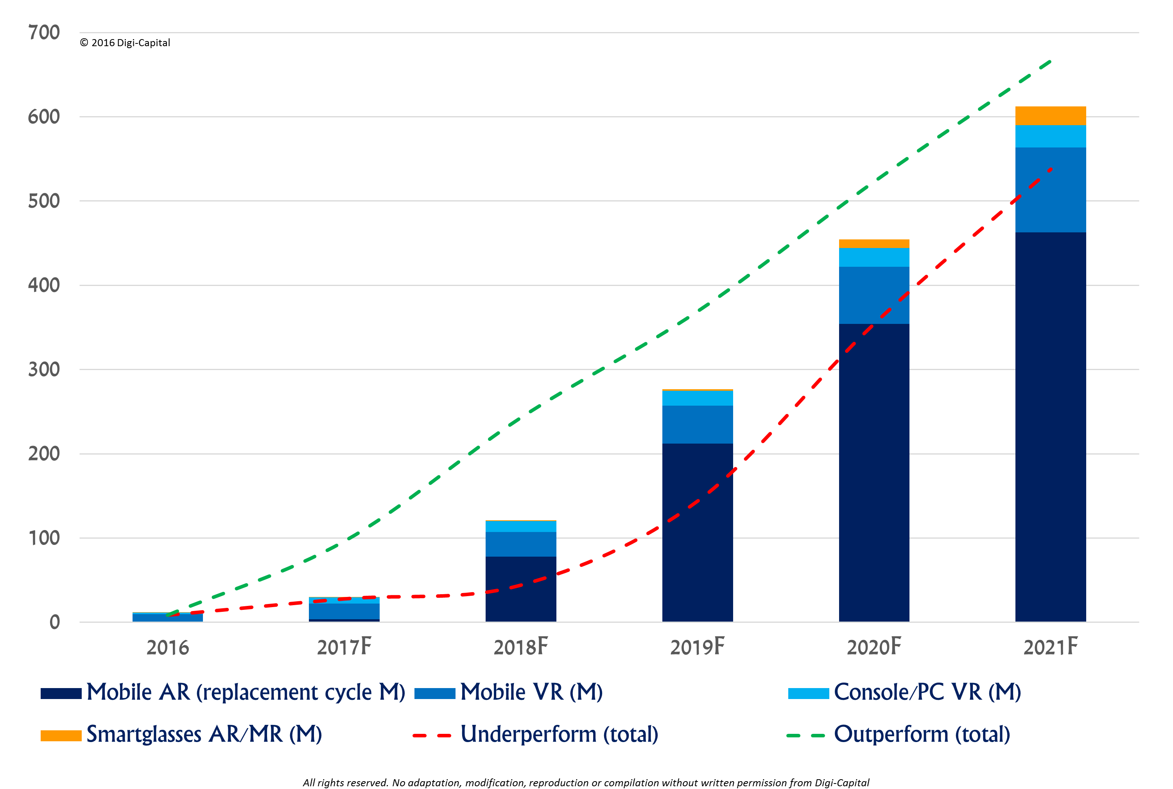
Virtual Reality has developed rapidly in recent years
Virtual Reality is projected to grow exponentially in five years to come.
Advancement in chips and other technologies is helping VR devices develop

Slide 6

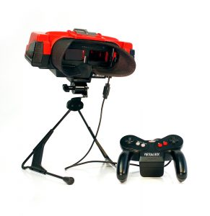
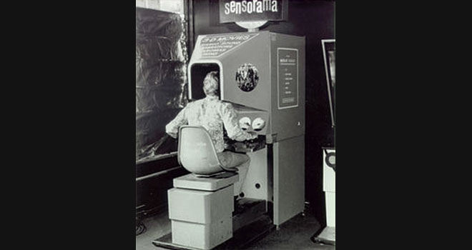
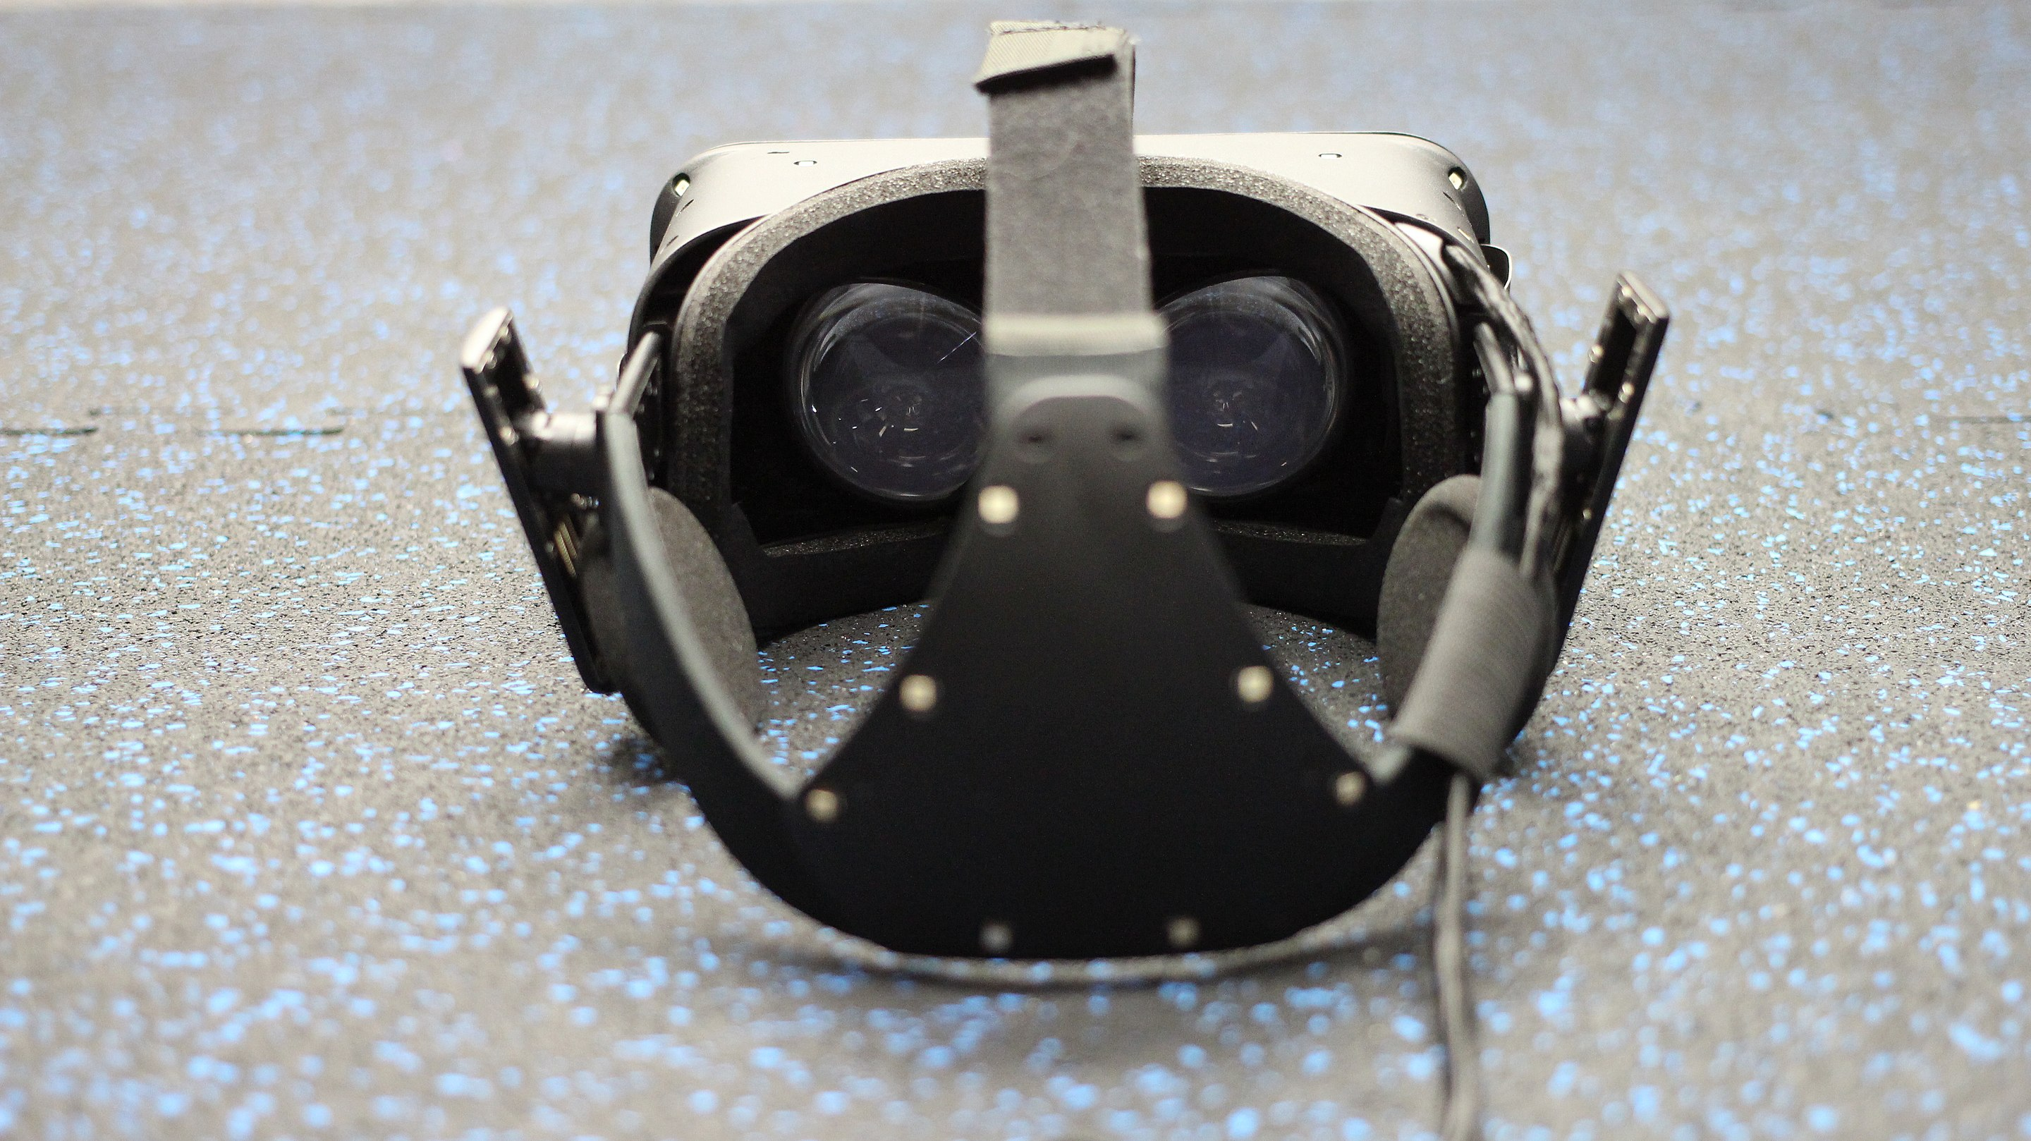
History of VR - Timeline of Events and Tech Development
1930s--first appeared in science fiction
1930s-1990s--concept products invented
1990s-2010s--Various attempts at commercialization
2010s-now--Successfully commercialized products emerge
oculus rift

Slide 7
Future forecast of VR
an increase is starting for the public interest in Virtual Reality
The application scenarios of VR will gradually increase
Increased availability and lower cost of VR products

Slide 8
Why VR in education
Notes:
Basically, there are three reasons to do this.

Slide 9
Blue Ocean
Notes:
The first reason to do this is blue ocean.

Slide 10
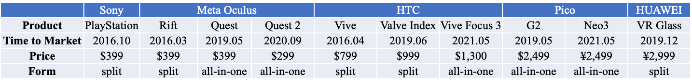
VR is currently in the blue ocean market
Competition is not fierce.
Suppliers are plentiful.
Notes:
Although there are many companies developing VR games, there are not many companies developing VR applications in education. Which means the competition in market is not fierce. This guarantee our company can be the pioneer.
Meanwhile the suppliers of VR equipment is plentiful like AR/VR chip manufacturers, NVIDIA Corporation, etc. They offer us many choices, so we can reduce costs of buying chips or some other devices.
VR is currently in the blue ocean market
Taking the product form as an example, the models launched by major brands since 2020 are basically all-in-one VR headsets. On the basis of the independent operation ability of the all-in-one machine, by upgrading the PC streaming technology, it can be connected via wireless or wired mode. PC connection, to achieve basically the same experience as the split VR, basically meet the needs of different types of users in different scenarios.

Slide 11
Virtual Reality is Promising in Education
Notes:
Secondly, VR is promising in education.

Slide 12
VR is promising in education
More attractive
More detail
Higher grades
Notes:
VR in education can make students be more attractive to the class.
Learning through experiences have long been considered superior to learning via simply reading or listening.
VR can be used to simulate scenarios right within the confines of the home or classroom and provide students with experience that are otherwise too difficult to replicate.
VR education can build a virtual learning environment through VR technology, such as simulating the motion of celestial bodies in the universe, chemical reactions and other difficult or risky scenarios in reality

Slide 13
Virtual Reality in Education is Profitable

Slide 14
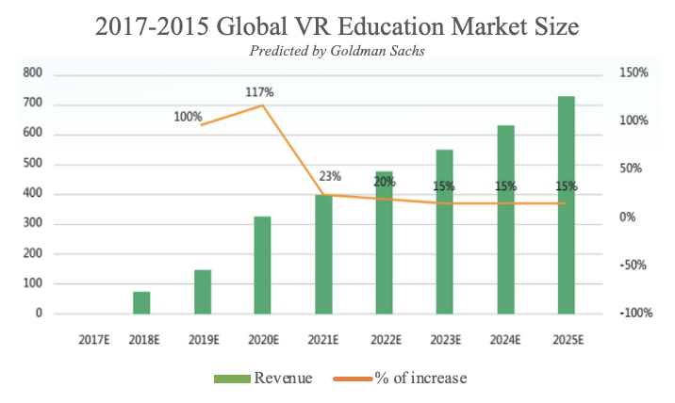
VR in education is profitable
VR software service is highly profitable.
VR in Education Market size developing rapidly.
Parents spend a lot in children’s education
Notes:
In the field of VR commercial use, educational applications are expected to take the lead in developing. This field has rigid demands, the user group is relatively clear, and the business model is relatively clear. According to Goldman Sachs forecast, the global VR education market is expected to exceed US$300 million in 2020 and is expected to exceed US$700 million in 2025.
According to IDC data, VR education is the largest application of commercial VR: VR education can build a virtual learning environment through VR technology, such as simulating the motion of celestial bodies in the universe, chemical reactions and other difficult or risky scenarios in reality ;VR vocational education is mainly used in driving schools, auto repair and other fields. According to Oriental Fashion data, the use of VR driving simulators can help driving schools save 30%-40% of operating costs.
Parents are spending $42 billion on early child education

Slide 15



VR in education is profitable
Education in School
Vocational Education
Corporate Training
VR education can build a virtual learning environment through VR technology.
According to Oriental Fashion data, the use of VR driving simulators can help driving schools save 30%-40% of operating costs.
Walmart trained 150,000 employees in VR in 2017.
Notes:
VR education as the largest application of commercial VR, it has many applicable business modes. And all these models have been successfully validated.
VR education can build a virtual learning environment through VR technology, such as simulating the motion of celestial bodies in the universe, chemical reactions and other difficult or risky scenarios in reality ;VR vocational education is mainly used in driving schools, auto repair and other fields. According to Oriental Fashion data, the use of VR driving simulators can help driving schools save 30%-40% of operating costs. VR can also play a role in corporate training, as Walmart trained 150,000 employees in VR in 2017.

Slide 16
Conclusion

Slide 17
Conclusion
VR in education is promising
VR in education is profitable
VR in education is attractive
Software service is the target

Slide 18
Q & A

Slide 19
References
https://www.cnbc.com/2020/01/27/parents-spending-42-billion-on-early-child-care-each-year.html
https://www.vrs.org.uk/virtual-reality/what-is-virtual-reality.html
https://www.marxentlabs.com/what-is-virtual-reality
https://r.datayes.com/details/report/4123413
https://r.datayes.com/details/report/4811797?tab=original

